Slide 1
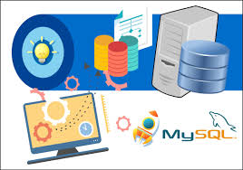
Lecture 2
Database System Concepts and Architecture
Dr. Anand Kumar M
Assistant Professor
Dept of IT
NITK

Slide 2
Outline
Database Systems
Data Models – Categories
Schemas
Schemas versus Instances
Three Schema Architecture
DBMS languages
Interfaces

Slide 3
Database Systems
Traditionally – Tightly integrated system
Modern – Modular in design (client/server)
Client – applications, user interface that access the DB
Server – Storage, access and search..

Slide 4
Data Models
Data Abstraction: Suppression of details of data organization and storage-
Data Model: A set of concepts to describe the structure of a database, and certain constraints that the database should obey.
Data Model Operations: Operations on the data model may include basic operations (retrieval and updates) and user-defined operations.

Slide 5
Categories of data models
Categorize according to the types of concepts they use to describe the database structure
Conceptual (high-level, semantic) data models: Provide concepts that are close to the way many users perceive data. (Also called entity-based or object-based data models.)
Physical (low-level, internal) data models: Provide concepts that describe details of how data is stored in the computer.
Implementation (representational) data models: Provide concepts that fall between the above two, balancing user views with some computer storage details.

Slide 6
Schemas versus Instances
Database Schema: The description of a database. Includes descriptions of the database structure and the constraints that should hold on the database.
Schema Diagram: A diagrammatic display of (some aspects of) a database schema.
Schema Construct: A component of the schema or an object within the schema, e.g., STUDENT, COURSE.
Database Instance: The actual data stored in a database at a particular moment in time. Also called database state (or occurrence).

Slide 7
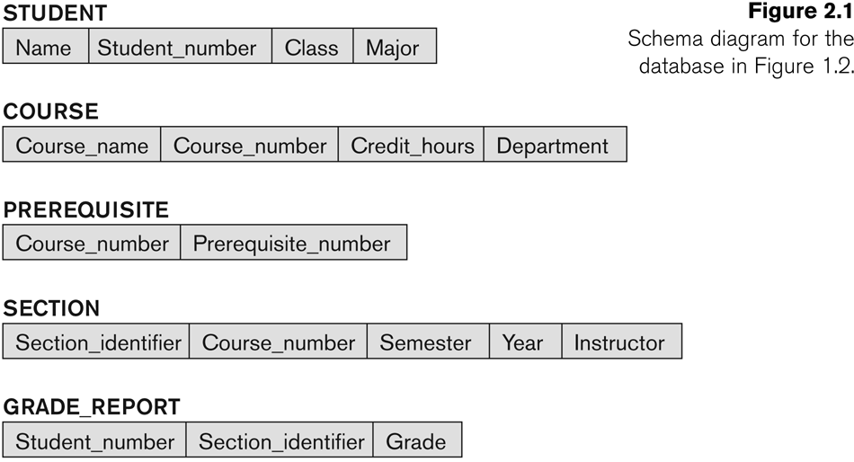
Schema Diagram

Slide 8
Database Schema Vs. Database State
Database State: Refers to the content of a database at a moment in time.
Initial Database State: Refers to the database when it is loaded
Valid State: A state that satisfies the structure and constraints of the database.
Distinction
The database schema changes very infrequently. The database state changes every time the database is updated.
Schema is also called intension, whereas state is called extension.

Slide 9
Three-Schema Architecture
Proposed to support DBMS characteristics of:
Program-data independence.
Support of multiple views of the data.

Slide 10
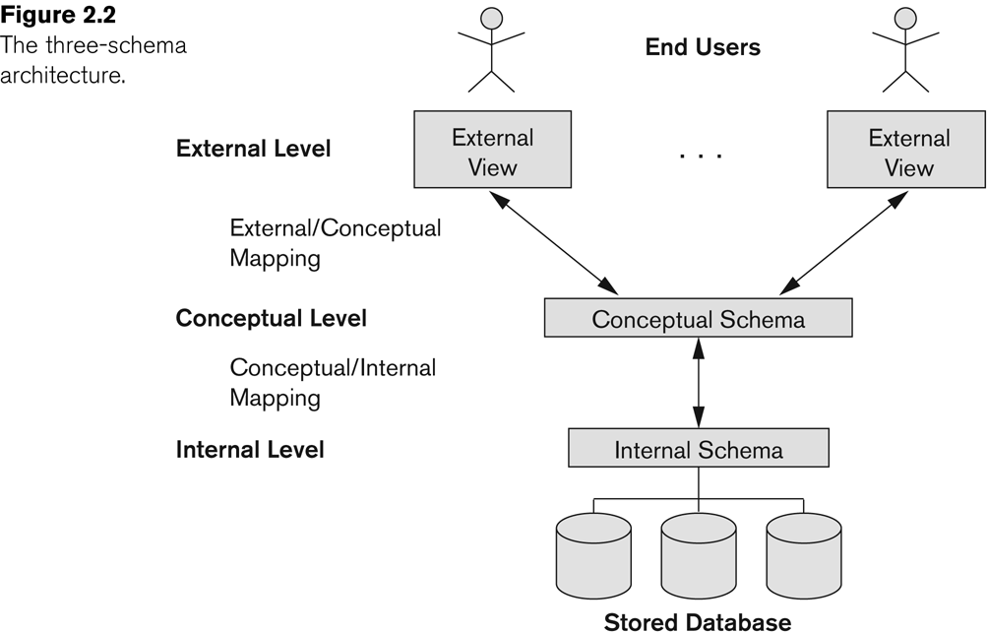
Three Schema Architecture

Slide 11
Three-Schema Architecture
Defines DBMS schemas at three levels:
Internal schema at the internal level to describe physical storage structures and access paths. Typically uses a physical data model.
Conceptual schema at the conceptual level to describe the structure and constraints for the whole database for a community of users. Uses a conceptual or an implementation data model.
External schemas at the external level to describe the various user views. Usually uses the same data model as the conceptual level. (conceptual or an implementation data model)

Slide 12
Three-Schema Architecture
Mappings among schema levels are needed to transform requests and data.
Programs refer to an external schema, and are mapped by the DBMS to the internal schema for execution.
Data extracted from the internal DBMS level is reformatted to match the user’s external view (e.g. formatting the results of an SQL query for display in a Web page)

Slide 13
Data Independence
Logical Data Independence: The capacity to change the conceptual schema without having to change the external schemas and their application programs.
Physical Data Independence: The capacity to change the internal schema without having to change the conceptual schema.

Slide 14
Three Schema Architecture
Logical Data Independence
Physical Data Independence

Slide 15
Data Independence
When a schema at a lower level is changed, only the mappings between this schema and higher-level schemas need to be changed in a DBMS that fully supports data independence. The higher-level schemas themselves are unchanged. Hence, the application programs need not be changed since they refer to the external schemas.

Slide 16
DBMS Languages
Data Definition Language (DDL): Used by the DBA and database designers to specify the conceptual schema of a database.
In many DBMSs, the DDL is also used to define internal and external schemas (views).
In some DBMSs, separate storage definition language (SDL) and view definition language (VDL) are used to define internal and external schemas.
Relational DBMSs, SQL is used in the role of VDL to define user or application views as results of predefined queries

Slide 17
DBMS Languages
Data Manipulation Language (DML): Used to specify database retrievals and updates.
DML commands (data sublanguage) can be embedded in a general-purpose programming language (host language), such as COBOL, C or an Assembly Language.
Alternatively, stand-alone DML commands can be applied directly (query language).
Two main types

Slide 18
DBMS Languages
High Level or Non-procedural Languages: e.g., SQL, are set-oriented and specify what data to retrieve than how to retrieve. Also called declarative languages.
Low Level or Procedural Languages: record-at-a-time; they specify how to retrieve data and include constructs such as looping.

Slide 19
DBMS Interfaces
User-friendly interfaces:
Menu-based interfaces - popular for browsing on the web - Menus do away with the need to memorize the specific commands and syntax of a query language
Forms-based- designed for naïve users - Users can fill out all of the form entries to insert new data, or they can fill out only certain entries, in which case the DBMS will retrieve matching data for the remaining entries
GUI/Graphics-based (Point and Click, Drag and Drop etc.) –Form and Menu

Slide 20
Other DBMS Interfaces
Natural language: requests in written English or other languages - dictionary of important words - dictionary of important words- to interpret the request. if successful , the interface generates a high-level query corresponding to the natural language request and submits it to the DBMS for processing. Else dialog is started with user to clarify the request.
Speech as Input and Output – speech for input and output to enable customers to access this information - The speech input is detected using a library of predefined words and used to set up the parameters that are supplied to the queries - output, a similar conversion from text or numbers into speech takes place.

Slide 21
Other DBMS Interfaces
Parametric interfaces (e.g., bank tellers) using function keys.
Interfaces for the DBA:
Creating accounts, granting authorizations
Setting system parameters
Changing schemas or access path

Slide 22
Database System Utilities
To perform certain functions such as:
Loading data stored in files into a database. Includes data conversion tools.
Backing up the database periodically on tape.
Reorganizing database file structures.
Report generation utilities.
Performance monitoring utilities-provides statistics to the DBA. The DBA uses the statistics in making decisions.
Other functions, such as sorting, user monitoring, data compression, etc.

Slide 23
Centralized and Client-Server Architectures
Mainframe -, including user application programs and user interface programs, as well as all the DBMS functionality.
Centralized DBMS: combines everything into single sys tem including- DBMS software, hardware, application programs and user interface processing software.

Slide 24
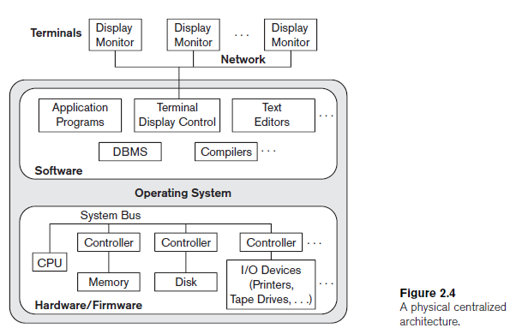

Slide 25
Basic Client-Server Architectures
Specialized Servers with Specialized functions
Clients
DBMS Server

Slide 26
Specialized Servers with Specialized functions:
File Servers
Printer Servers
Web Servers
E-mail Servers

Slide 27
Clients:
Provide appropriate interfaces and a client-version of the system to access and utilize the server resources.
Clients maybe diskless machines or PCs or Workstations with disks with only the client software installed.
Connected to the servers via some form of a network. (LAN: local area network, wireless network, etc.)

Slide 28
DBMS Server
Provides database query and transaction services to the clients
Sometimes called query and transaction servers

Slide 29
Two Tier Client-Server Architecture
User Interface Programs and Application Programs run on the client side
Interface called ODBC (Open Database Connectivity ) provides an Application program interface (API) allow client side programs to call the DBMS. Most DBMS vendors provide ODBC drivers.

Slide 30
Two Tier Client-Server Architecture
A client program may connect to several DBMSs.
Other variations of clients are possible: e.g., in some DBMSs, more functionality is transferred to clients including data dictionary functions, optimization and recovery across multiple servers, etc. In such situations the server may be called the Data Server.

Slide 31
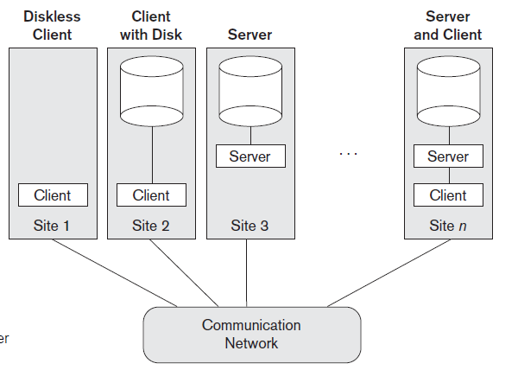

Slide 32
Three Tier Client-Server Architecture
Common for Web applications
Intermediate Layer called Application Server or Web Server:
stores the web connectivity software and the rules and business logic (constraints) part of the application used to access the right amount of data from the database server
acts like a conduit for sending partially processed data between the database server and the client.
Additional Features- Security:
encrypt the data at the server before transmission
decrypt data at the client

Slide 33
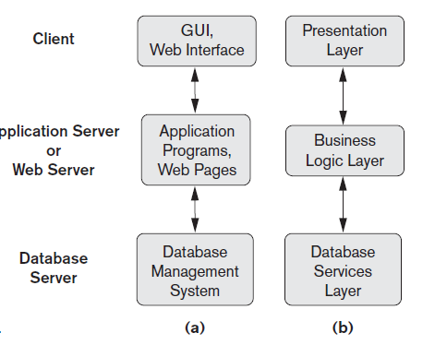

Slide 34
Classification of DBMSs
Based on the data model used:
Traditional: Relational, Network, Hierarchical.
Emerging: Object-oriented, Object-relational.
Other classifications:
Single-user (typically used with micro- computers) vs. multi-user (most DBMSs).
Centralized (uses a single computer with one database) vs. distributed (uses multiple computers, multiple databases)

Slide 35
Classification of DBMSs
Distributed Database Systems have now come to be known as client server based database systems because they do not support a totally distributed environment, but rather a set of database servers supporting a set of clients.

Slide 36
Variations of Distributed Environments:
Homogeneous DDBMS - use the same DBMS software at all the sites
Heterogeneous DDBMS - can use different DBMS software at each site

Slide 37
Summary

